Slide 1
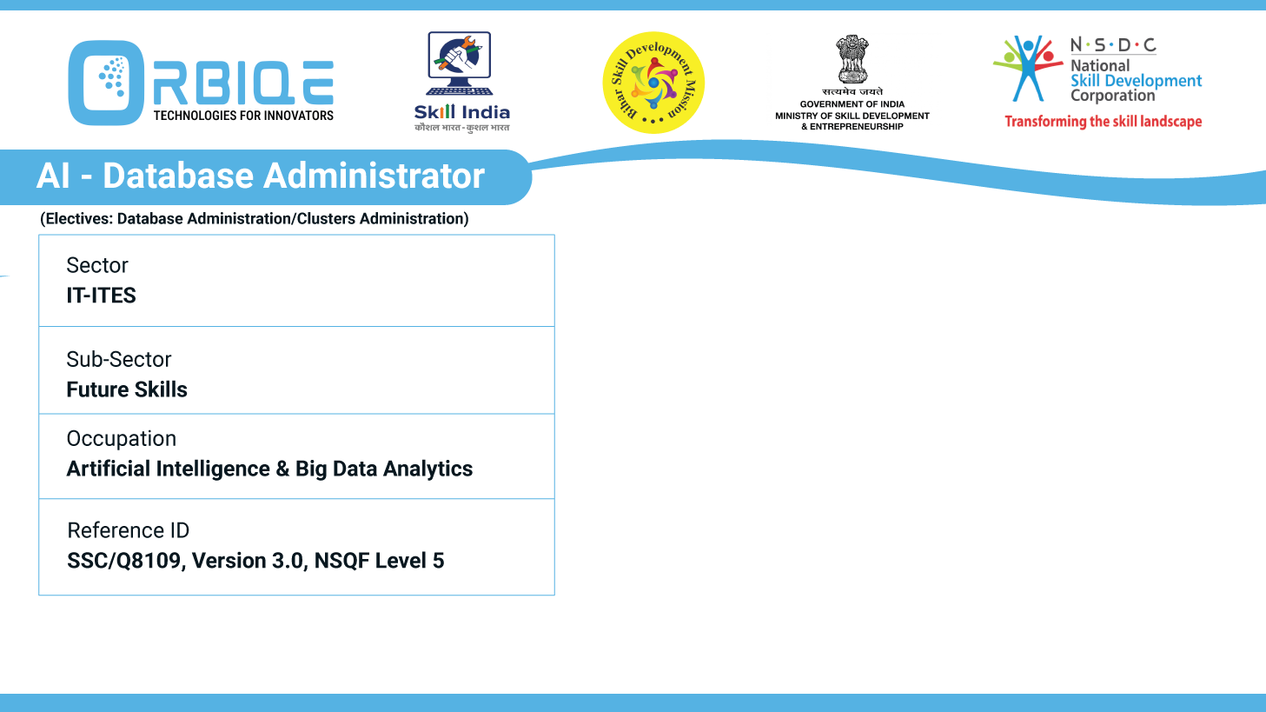
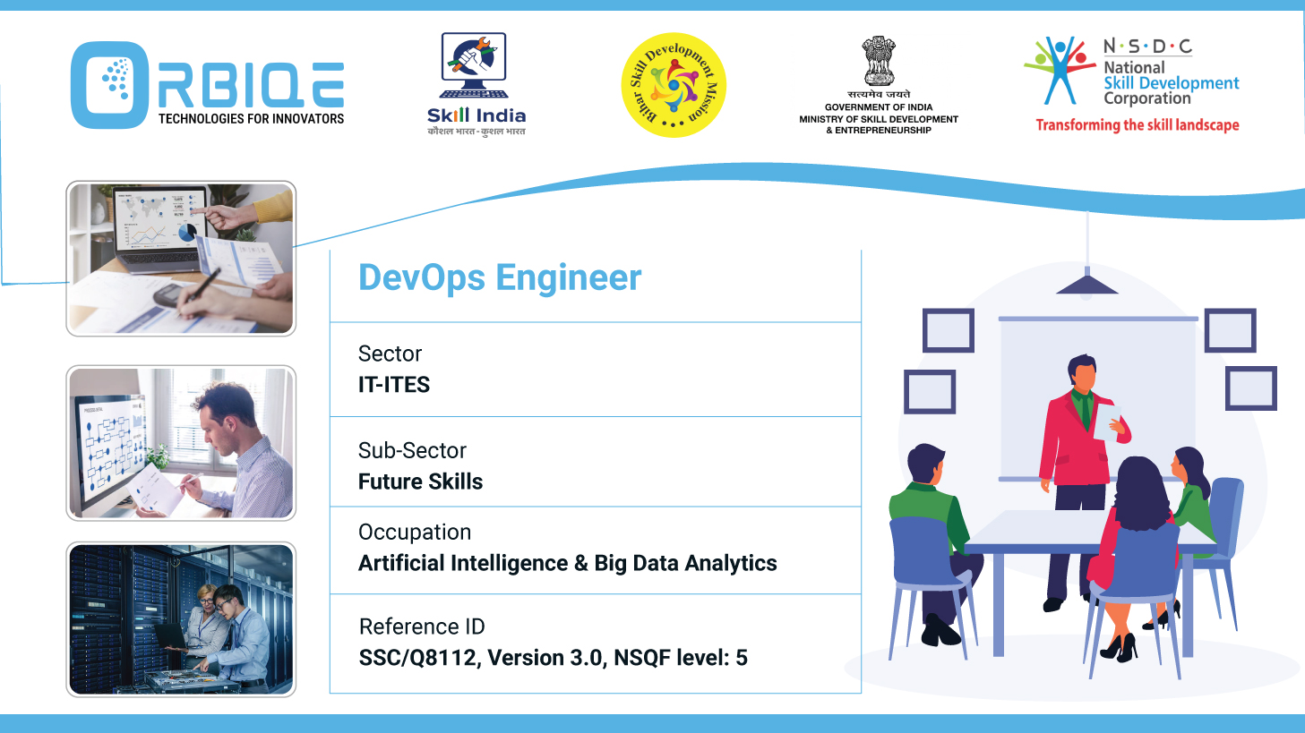
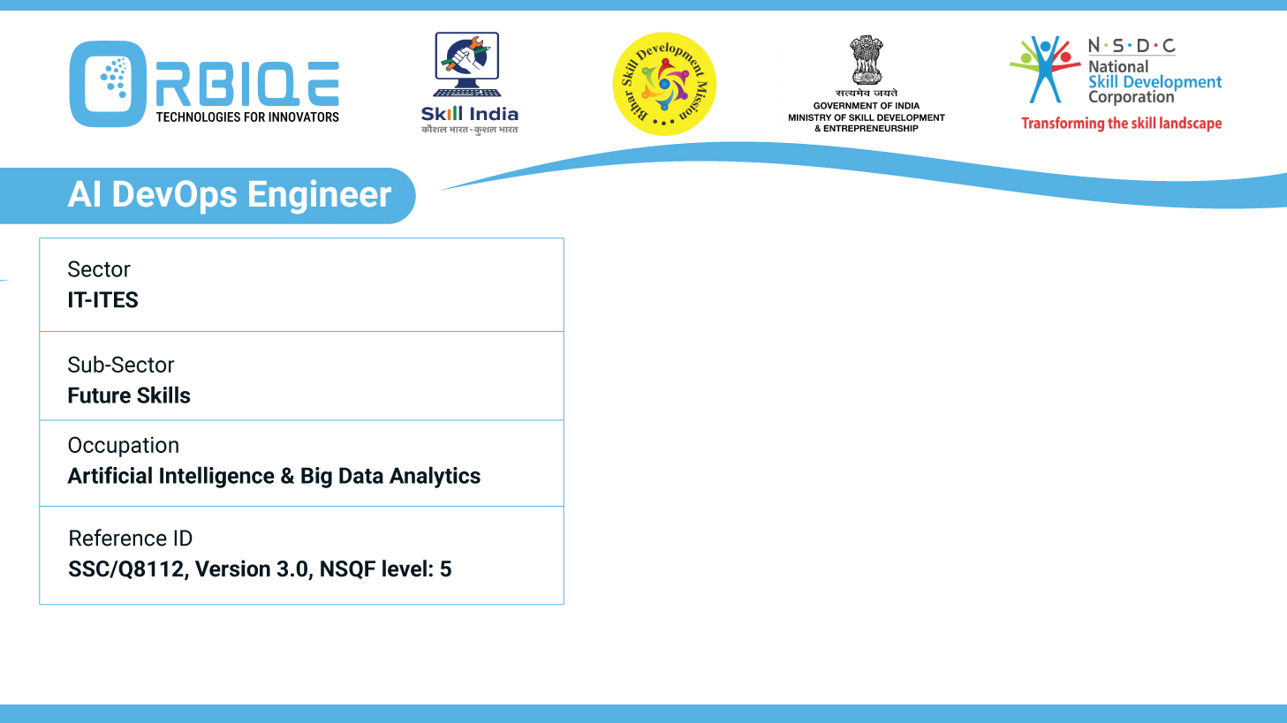
Name- Krishna Kant Dubey

Slide 2

Strategic Database Selection: Matching Types with Analysis Needs

Slide 3
Agenda
Discuss methods to select the right database type, ensuring alignment with analysis requirements and optimizing database performance for AI Database Administration

Slide 4
Method to Select the Right Database
The Use Case and Analysis Requirements
Data Characteristics to Database Types
Optimize for AI-Driven Performance
Evaluate Performance Trade-offs
Use AI Tools to Assist in Selection

Slide 5
The Use Case and Analysis Requirements
Requirement Type | Key Questions to Ask
Data Structure | Is the data structured, semi-structured, or unstructured?
Query Complexity | Do you need complex joins, aggregations, or graph traversals?
Volume & Velocity | Is the data high-volume, real-time, or batch-oriented?
Access Patterns | Are reads or writes more frequent? Is latency critical?
AI/ML Integration | Will the database feed models or support real-time inference?

Slide 6
Data Characteristics to Database Types
Data Type | Recommended DB Type
Structured (tabular) | Relational (PostgreSQL, MySQL)
Semi-structured (JSON) | Document Store (MongoDB)
Key-based lookup | Key-Value Store (Redis, DynamoDB)
Time-series | Time-Series DB (InfluxDB, TimescaleDB)
Relationship-heavy | Graph DB (Neo4j, Neptune)
Analytical workloads | Columnar DB (BigQuery, Snowflake)

Slide 7
Optimize for AI-Driven Performance
Automation & Self-Tuning
Aurora & Snowflake: Auto-scaling, auto-indexing, and workload-aware optimization
AI-enhanced RDBMS: Use tools like Oracle Autonomous DB or SQL Server Intelligent Query Processing
Predictive Analytics Integration
Vector search (e.g., Pinecone, Weaviate for embeddings)
ML model hosting (e.g., BigQuery ML, PostgreSQL with pgvector)

Slide 8
Evaluate Performance Trade-offs
Factor | Considerations
Latency | In-memory DBs (Redis) for sub-ms response
Throughput | Columnar DBs for bulk analytics
Consistency | RDBMS for ACID; NoSQL for eventual consistency
Scalability | NoSQL and cloud-native DBs scale horizontally
Availability | Multi-region replication, failover support

Slide 9
Use AI Tools to Assist in Selection
AI-powered DBAs can leverage tools like:
Query workload analysers: Identify bottlenecks and suggest schema changes
Data profiling engines: Classify data types and recommend storage models
AI-based migration advisors: Suggest optimal DB types during cloud migration

Slide 10
Thank You

